Slide 1
Sprint 5
Hydrostatic pressure AO, LS and TC detection

Slide 2
Agenda
Theoretical underpinnings:
Custom AO, LS and TC hydrostatic pressure detection
v0.05 (AO and LS detector)
v0.06 (AO, LS and TC detector)
Next steps
Notes:
Vraag sprint 4: kunnen we in de resterende tijd iets maken dat tsoutliers-beperkingen omzeilt: vervolg is samenvatting van mijn poging.

Slide 3
Theoretical underpinnings
Hydrostatic pressure AO, LS and TC detection

Slide 4
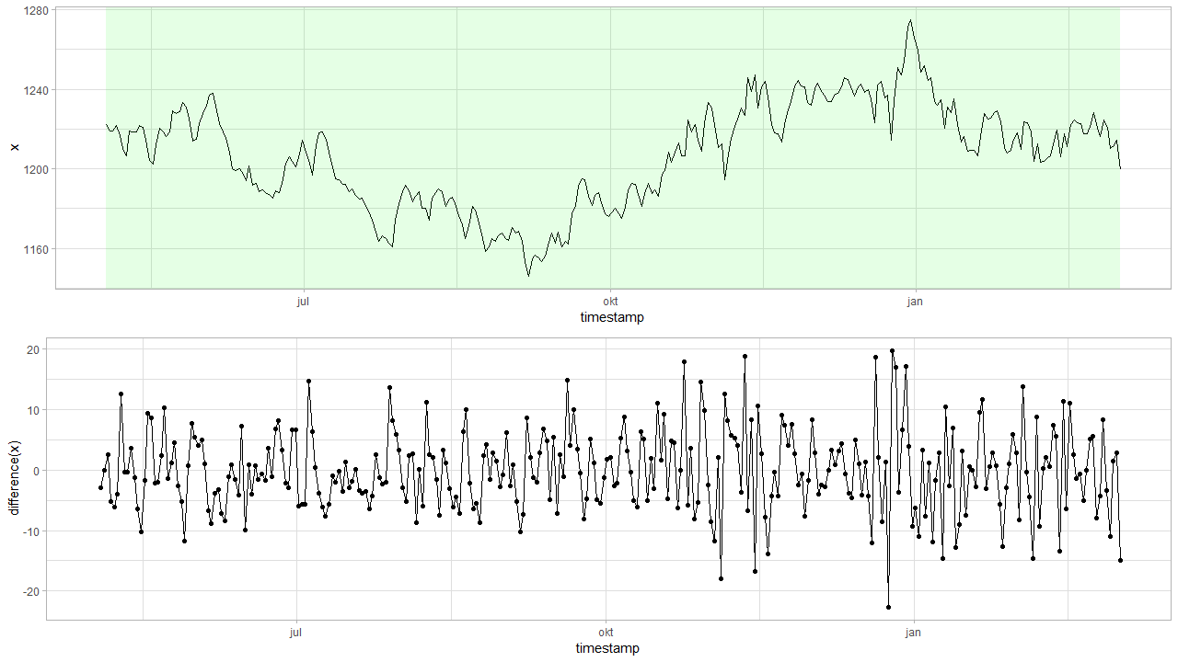

Model: $z_{t}=z_{t−1}+ε$
DYLP126X_F6843.csv
Notes:
Assumptie: simple first order diff model

Slide 5

Differences: $z_{t}−z_{t−1}=ε$
Notes:
How is epsilon distributed?

Slide 6
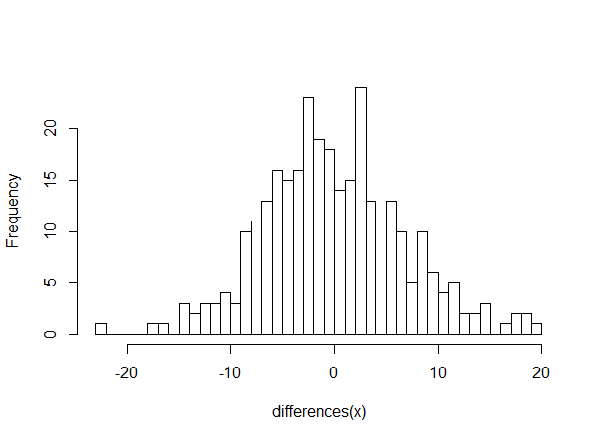

Differences: $z_{t}−z_{t−1}=ε$
$$Δt=1 day$$
Notes:
Normal? Something else?

Slide 7
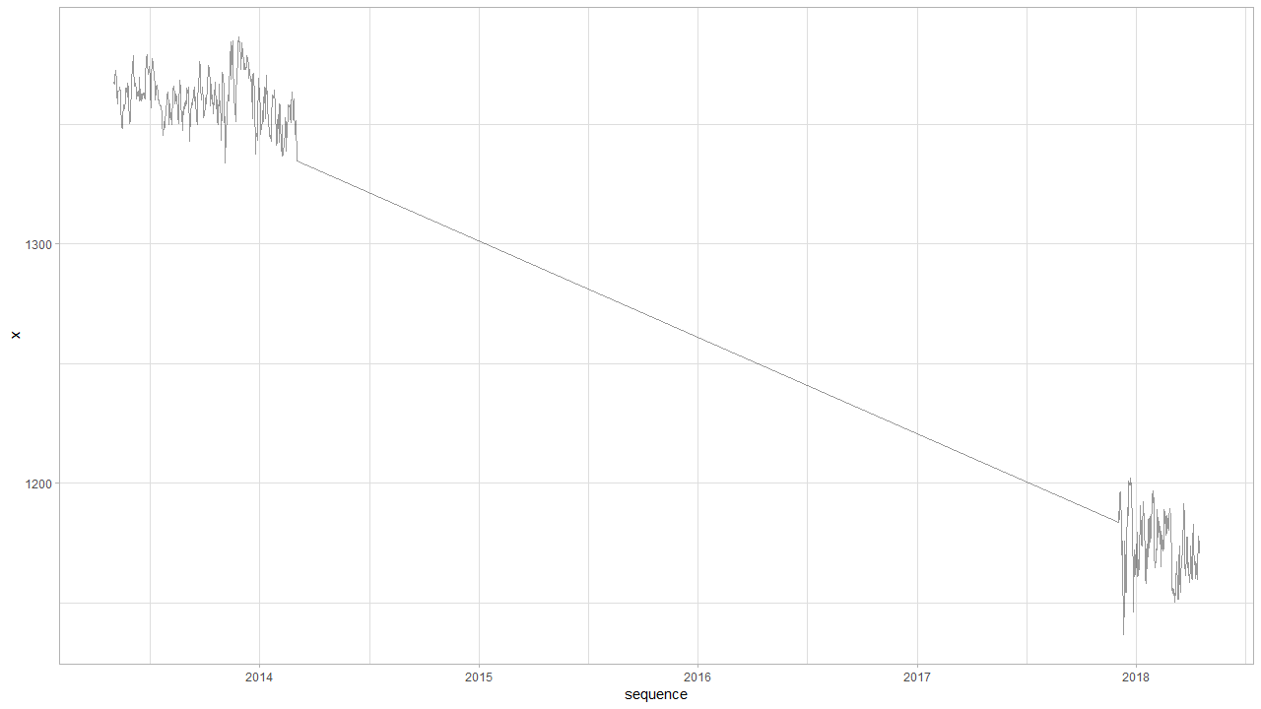

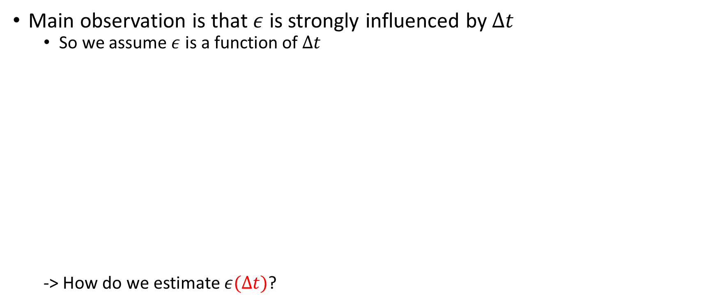
Observation: $z_{t}−z_{t−1}=ε(Δt)$
Main observation is that $ε$ is strongly influenced by $Δt$
So we assume $ε$ is a function of $Δt$
-> How do we estimate $ε(Δt)$?
Notes:
Big observation is that epsilon is a function of time: hoe plausible is het dat er na zo veel tijd zo’n grote jump is?

Slide 8
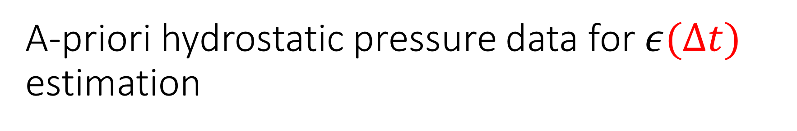
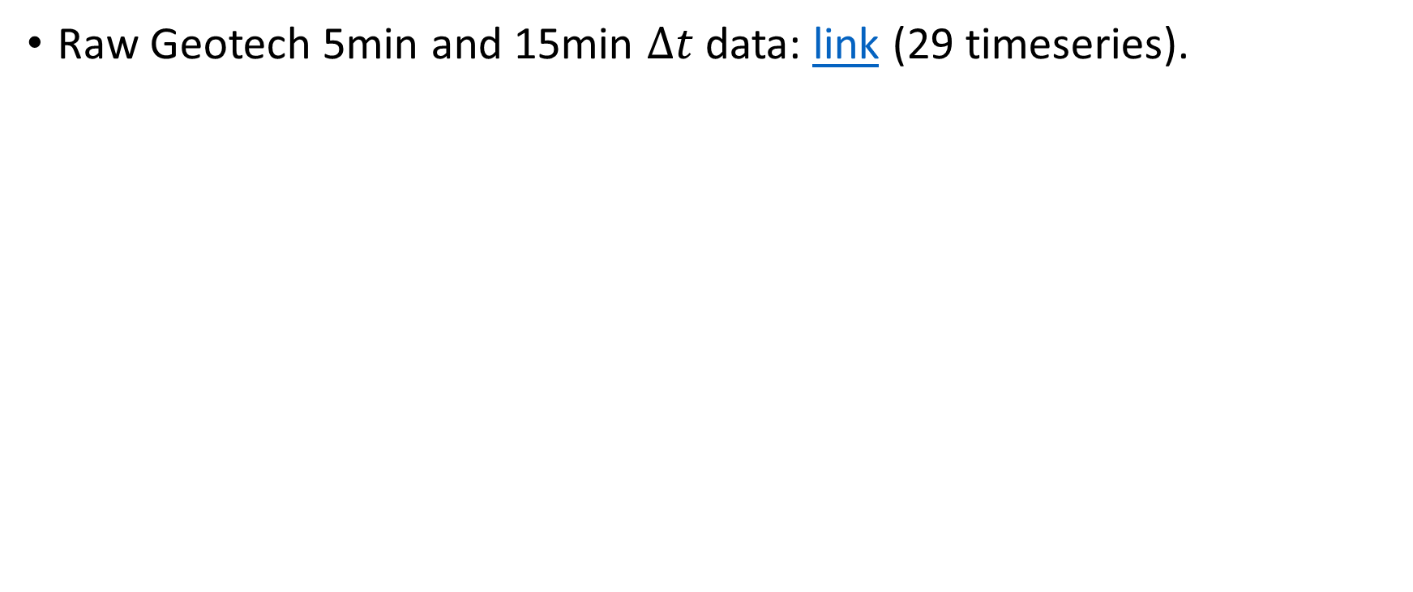
A-priori hydrostatic pressure data for $ε(Δt)$ estimation
Raw Geotech 5min and 15min $Δt$ data: link (29 timeseries).

Slide 9
Why not subsample intervals?
Problem
In case of very large intervals (e.g. month or more): only a few samples
Subsampling
Intuitively: not how a real logger works.
Independence assumption: does not work in case of subsampling.

Slide 10
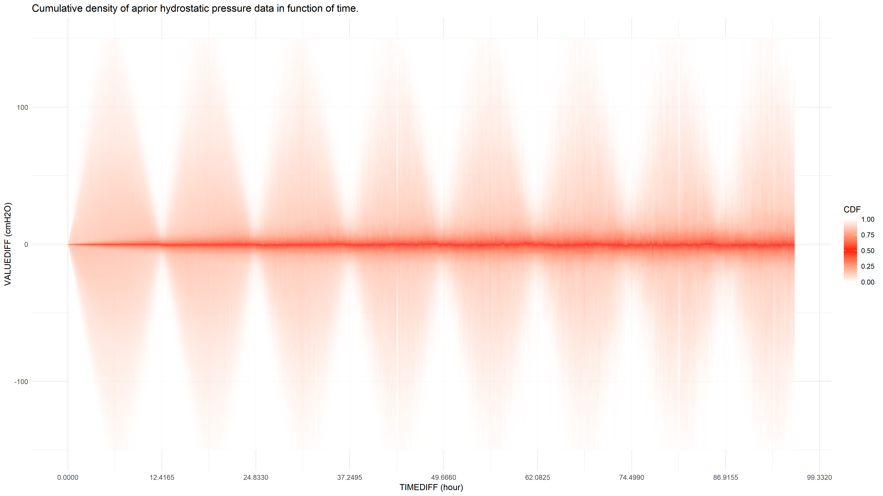

Density of $ε(Δt)$

Slide 11
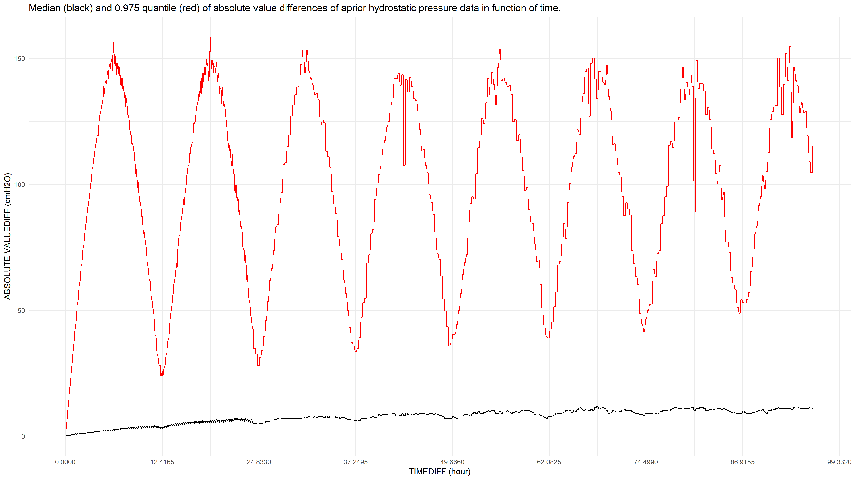

Median and 0.975 quantile of abs($ε(Δt)$)

Slide 12
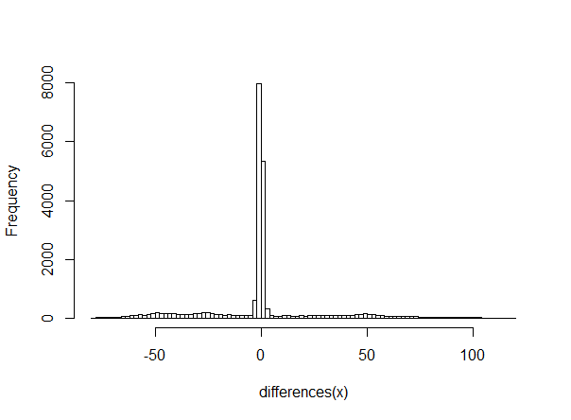
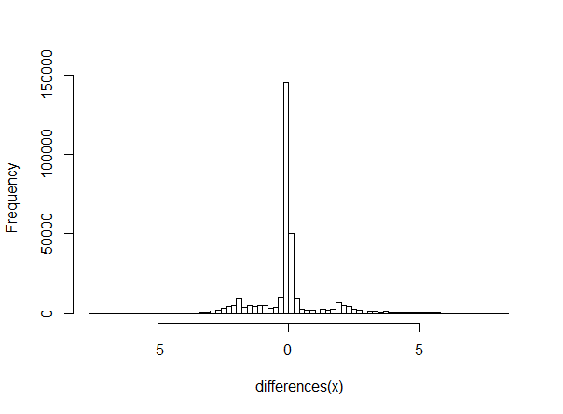
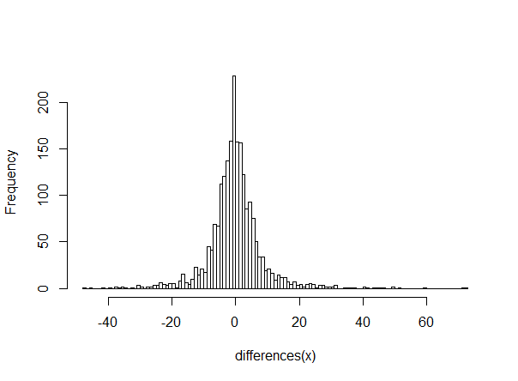



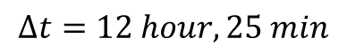
Distribution of $ε(Δt)$
$$Δt=1 hour$$
$$Δt=5 min$$
$$Δt=12 hour, 25 min$$
Removing tidal effect results in quasi-normality?
Notes:
Eens tidal effect is uitgefilterd lijkt het vrij normaal!
Now that we have the distribution we can start detecting:

Slide 13
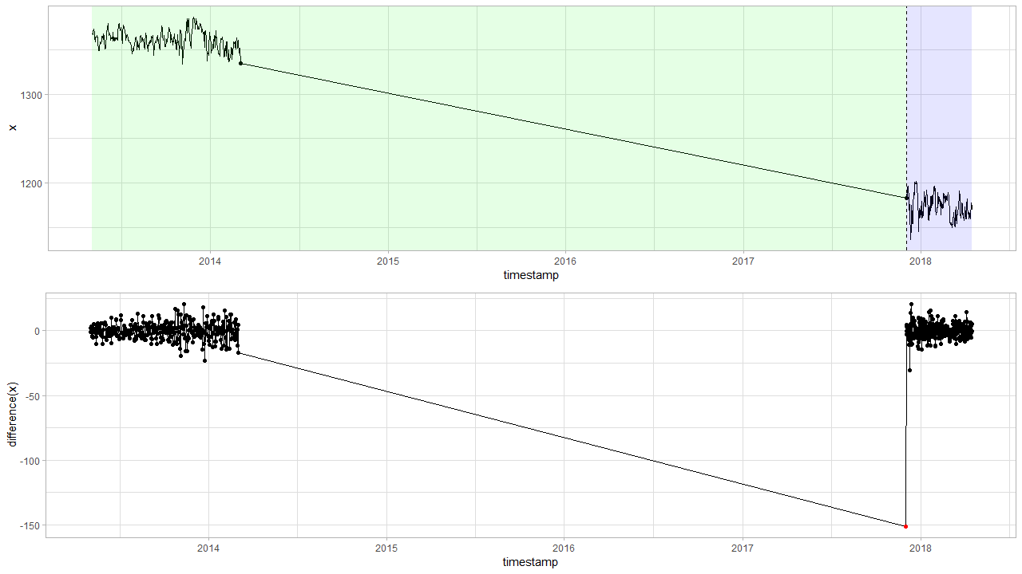

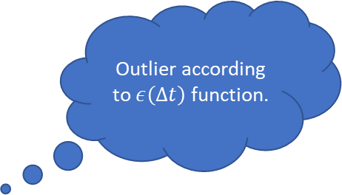
Detection based on a-priori information: $$z_{t}−z_{t−1}=ε(Δt)$$
Outlier according to $ε\left(Δt\right)$ function.

Slide 14
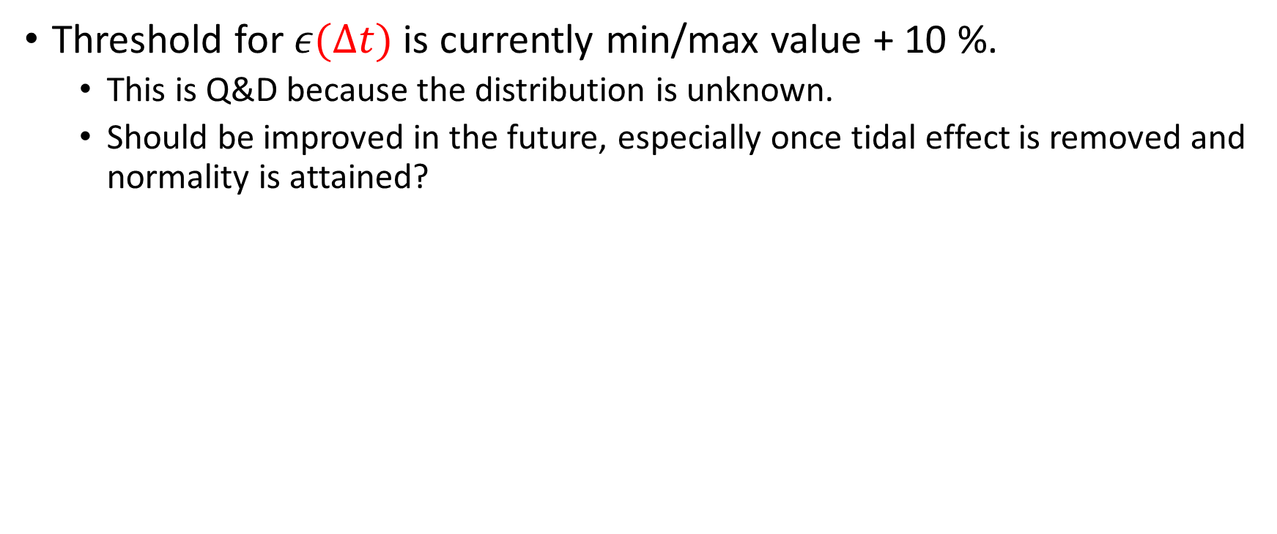

ToDo
Threshold for $ε(Δt)$ is currently min/max value + 10 %.
This is Q&D because the distribution is unknown.
Should be improved in the future, especially once tidal effect is removed and normality is attained?
$$Δt=5 min$$

Slide 15

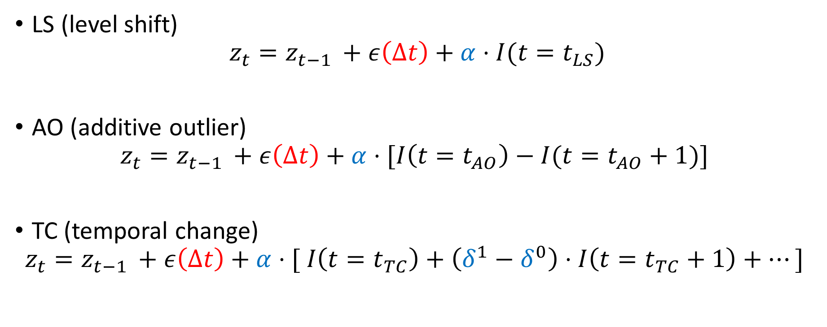
Outliers on a-priori $ε(Δt)$ can have different interpretations
Still looking for more simple formalization methods.
LS (level shift)
$$z_{t}=z_{t−1 }+ε\left(Δt\right)+α⋅I(t=t_{LS})$$
AO (additive outlier)
$$z_{t}=z_{t−1 }+ε\left(Δt\right)+α⋅[I\left(t=t_{AO}\right)−I(t=t_{AO}+1)]$$
TC (temporal change)
$$z_{t}=z_{t−1 }+ε\left(Δt\right)+α⋅[ I\left(t=t_{TC}\right)+\left(δ^{1}−δ^{0}\right)⋅I\left(t=t_{TC}+1\right)+…]$$
Notes:
Ben nog aan het zien naar betere/simpelere formalisatiemethode…

Slide 16
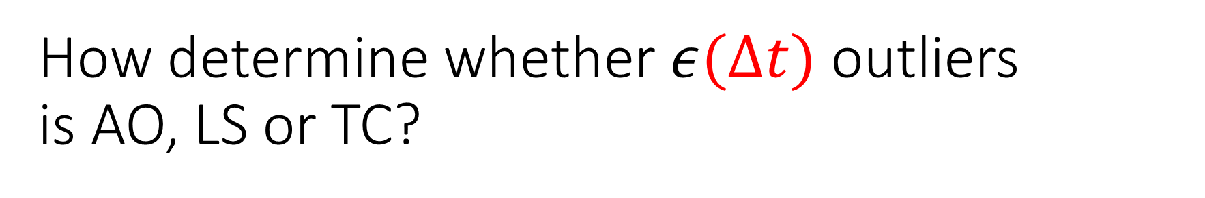
How determine whether $ε(Δt)$ outliers is AO, LS or TC?
Engineering approach
Simple at first sight, but becomes quite complex once special cases or TC is added
Not a real option
Statistical approach
Likelihood function needed
3 contenting models for each point AO, LS and TC

Slide 17
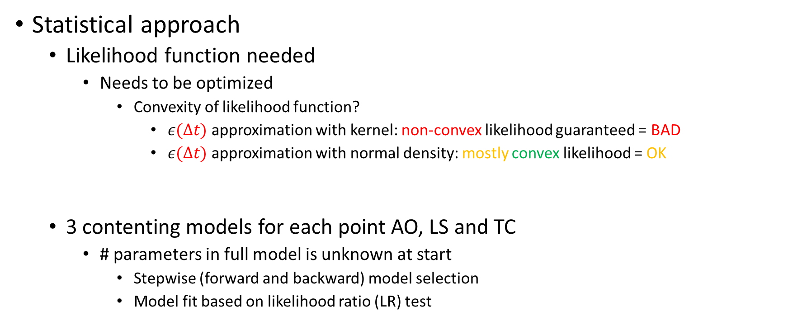
How determine whether $ε(Δt)$ outliers is AO, LS or TC?
Statistical approach
Likelihood function needed
Needs to be optimized
Convexity of likelihood function?
$ε(Δt)$ approximation with kernel: non-convex likelihood guaranteed = BAD
$ε(Δt)$ approximation with normal density: mostly convex likelihood = OK
3 contenting models for each point AO, LS and TC
# parameters in full model is unknown at start
Stepwise (forward and backward) model selection
Model fit based on likelihood ratio (LR) test
Notes:
We schatten dus epsilon(delta-t) op basis van normaliteit omdat de kans kleiner is dat we dan in een locale minima belanden.

Slide 18
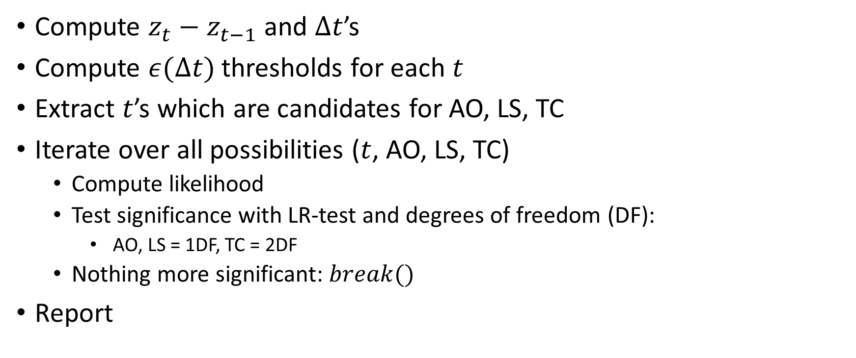
AO, LS, TC detection algorithm summary
Compute $z_{t}−z_{t−1}$ and $Δt$’s
Compute $ε(Δt)$ thresholds for each $t$
Extract $t$’s which are candidates for AO, LS, TC
Iterate over all possibilities ($t$, AO, LS, TC)
Compute likelihood
Test significance with LR-test and degrees of freedom (DF):
AO, LS = 1DF, TC = 2DF
Nothing more significant: $break()$
Report
type index alpha delta
1: AO 10824 -108.0 NA
2: AO 17175 -91.5 NA
3: LS 22552 -80.0 NA

Slide 19
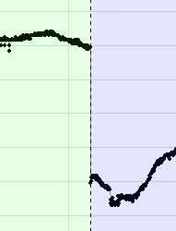
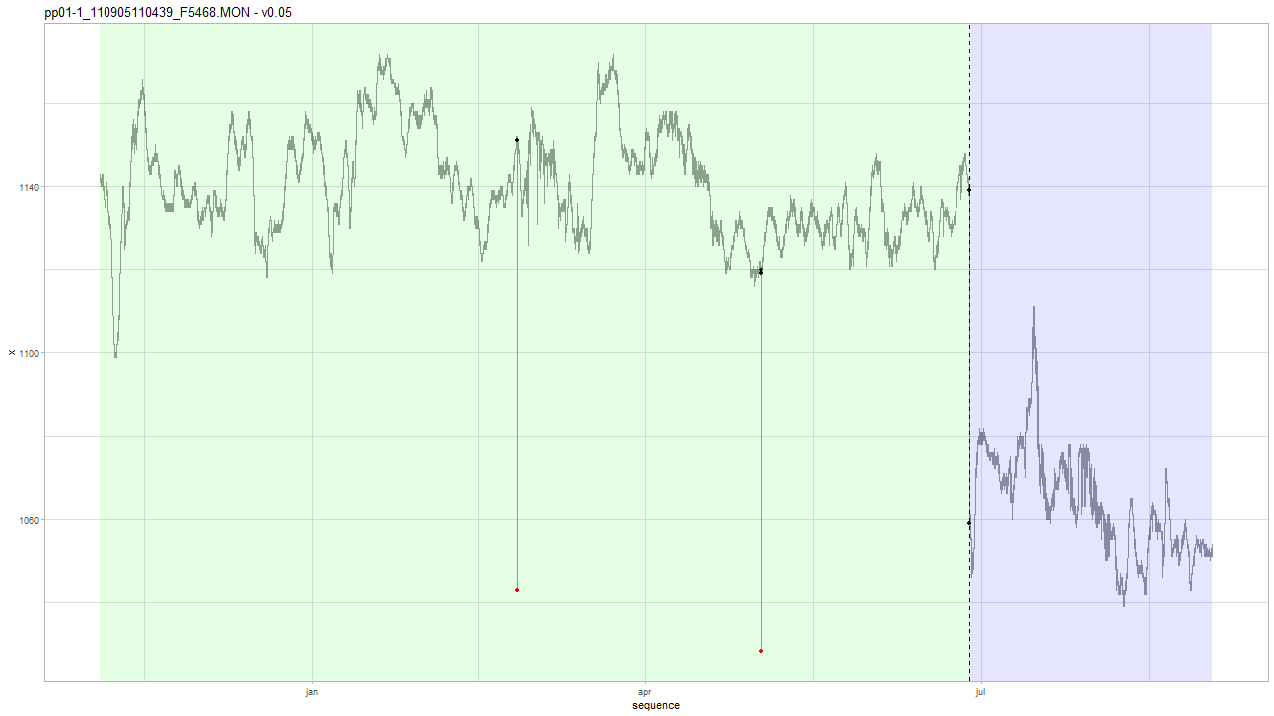
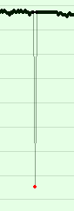
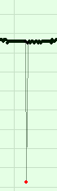
Example: Geotech v0.05
type index alpha delta
1: AO 10824 -108.0 NA
2: AO 17175 -91.5 NA
3: LS 22552 -80.0 NA
Notes:
type index alpha delta
1: AO 10824 -108.0 NA
2: AO 17175 -91.5 NA
3: LS 22552 -80.0 NA

Slide 20
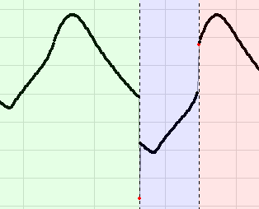
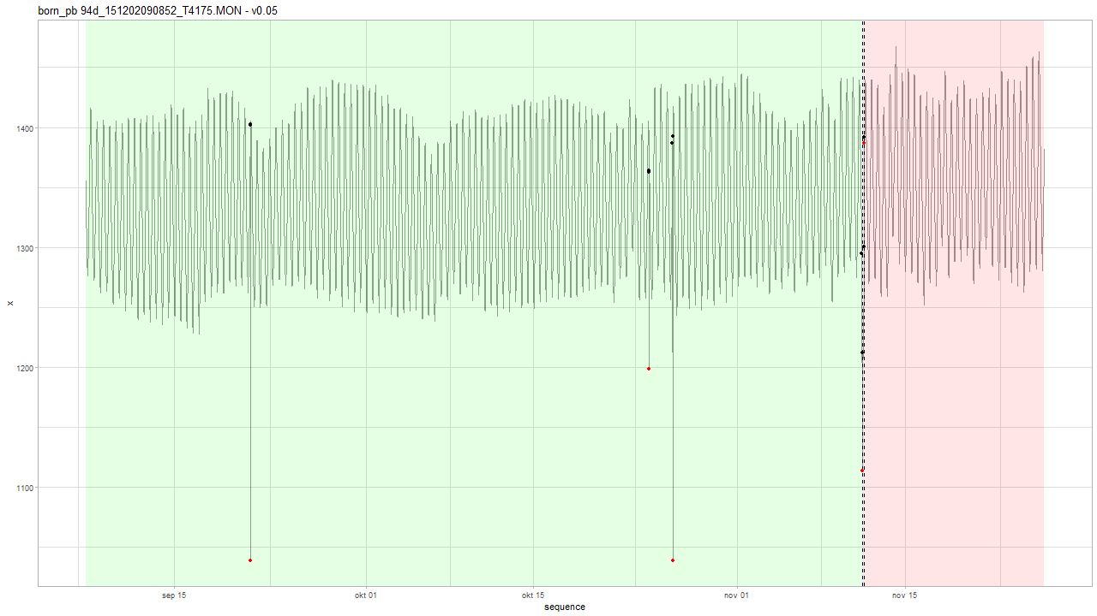
Example: Geotech v0.05
AO and LS at the same time.
Notes:
type index alpha delta
1: AO 3968 -363.446 NA
2: AO 13555 -164.792 NA
3: AO 14117 -351.283 NA
4: AO 18671 -98.525 NA
5: LS 18671 -83.125 NA
6: LS 18731 91.175 NA
7: AO 18731 -4.842 NA

Slide 21
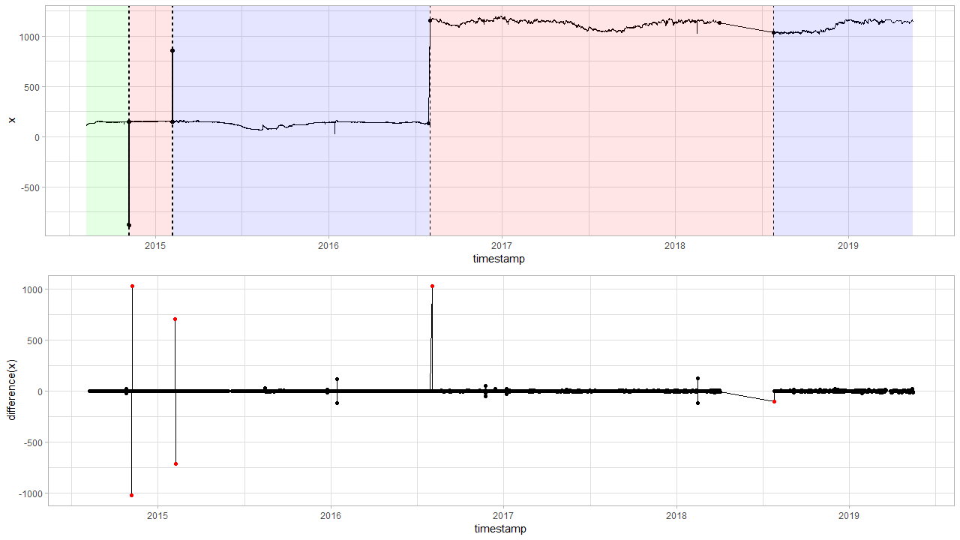
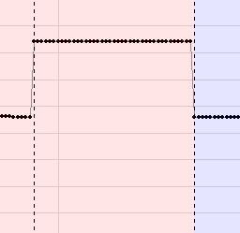
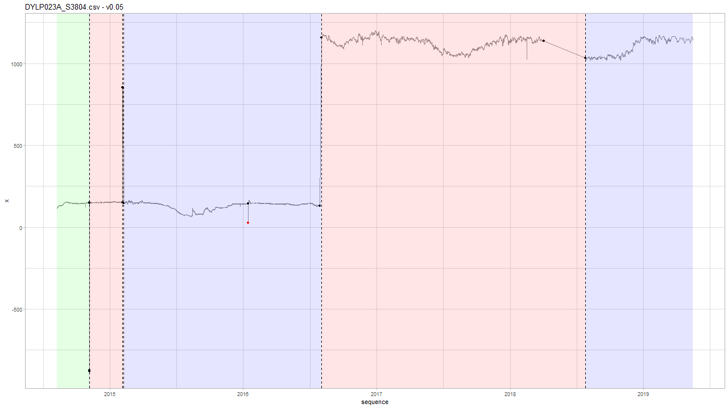
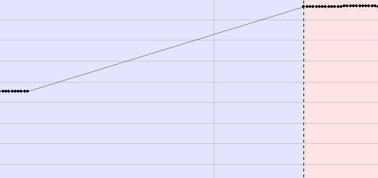
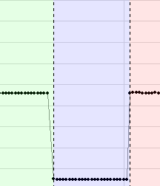
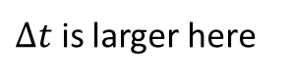
Example: INBO v0.05
Levelshift detection
$Δt$ is larger here
Notes:
Levelshifts voorbeelden.

Slide 22
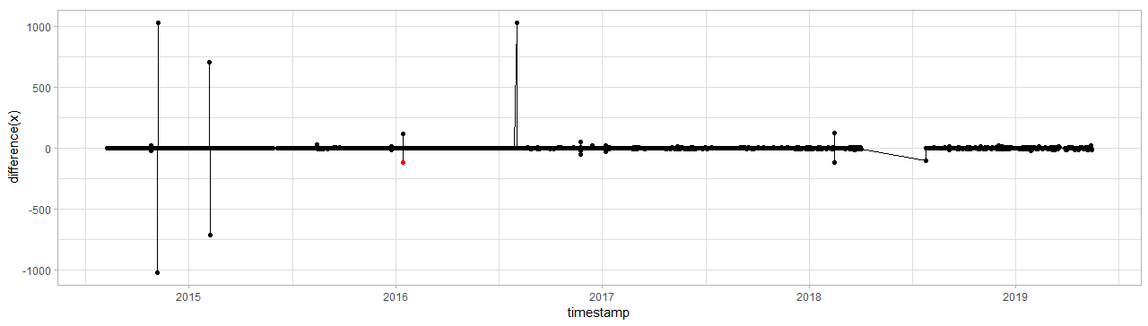
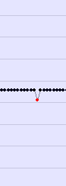
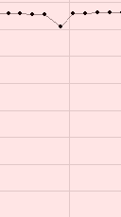
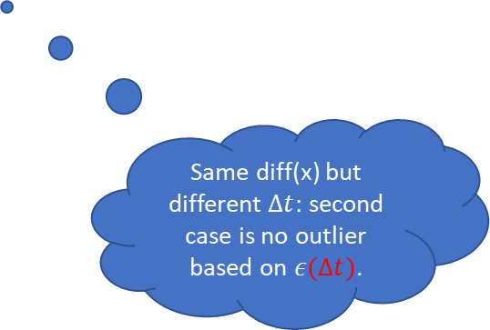
Example: INBO v0.05
Outlier detection
Same diff(x) but different $Δt$: second case is no outlier based on $ε(Δt)$.
Notes:
Levelshifts voorbeelden.

Slide 23
DYLP023A_S3804
tsdiff vdiff lower.bound upper.bound mu sigma2 n.dens c outlier
3600 -119.1260886 -41.5 75.9 0.000790494 176.504 42216 5.533473 TRUE
3600 118.8260229 -41.5 75.9 0.000790494 176.504 42216 5.533473 TRUE
14400 -116.9593409 -135.8 172.5 -0.011306911 1776.242 10539 4.916277 FALSE
10800 122.2678611 -114.8 149.9 0.001284348 1201.918 14062 5.319899 FALSE
Notes:
Hier is te zien dat er bij de eerste timediff 1u is, terwijl bij 2e om een langere periode gaat.

Slide 24
v0.05
AO and LS detection
(Comparison with Sprint 3 LS discussion)

Slide 25
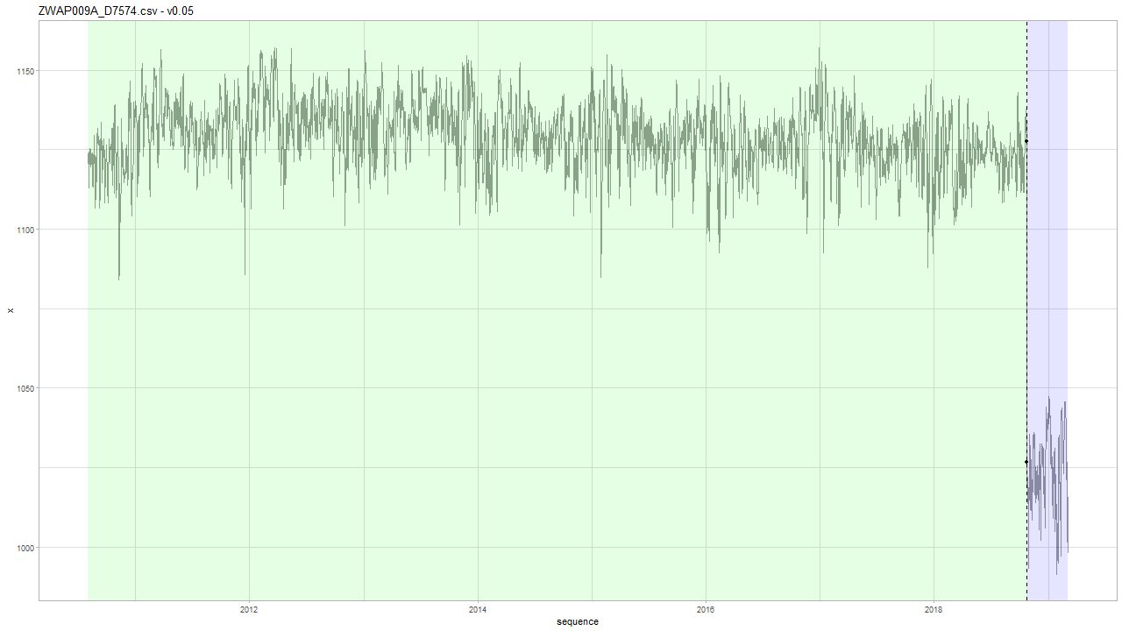
INBO: v0.05
Note: v0.05 has never seen INBO data, only 29 timeseries of Geotech data.

Slide 26
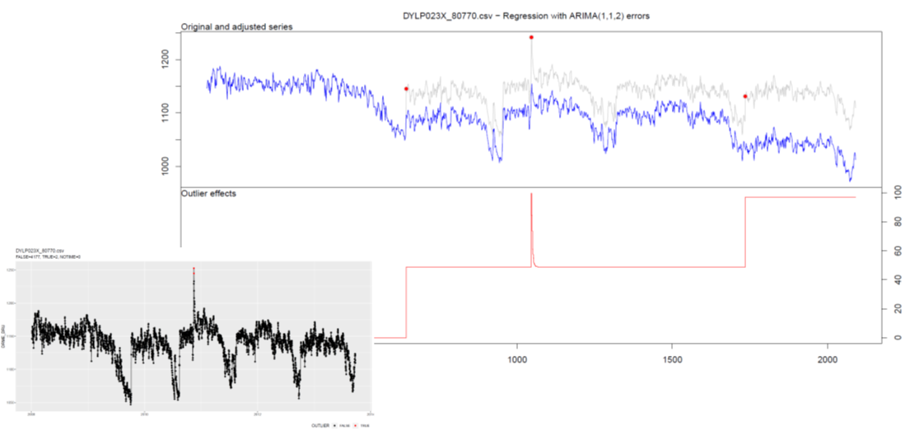
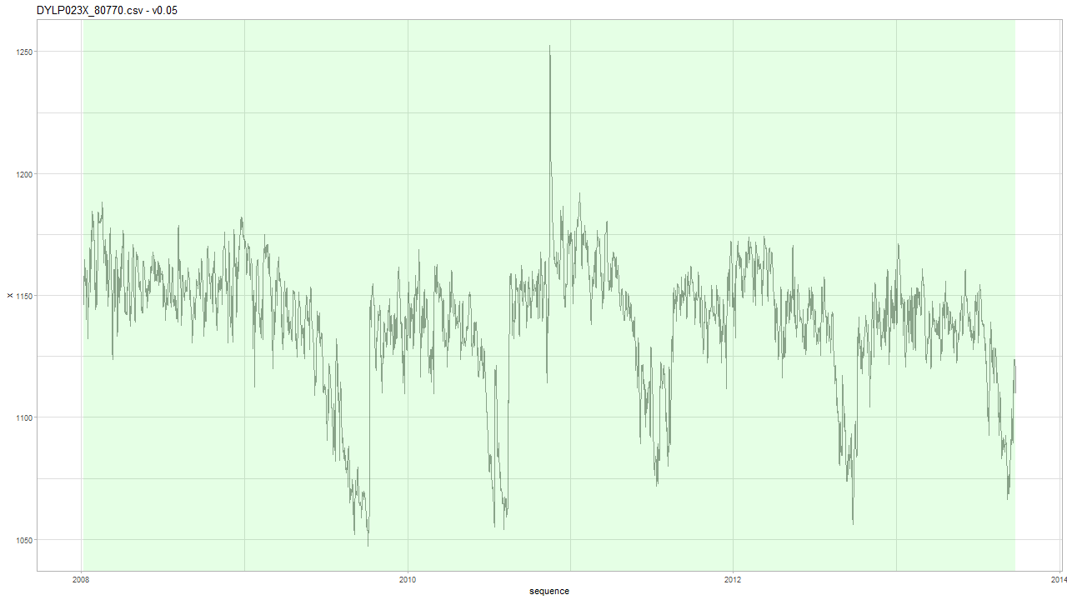
INBO: v0.05
Mathias: location is known. Dijle-valley. Highest peak is a flood. The other two are due to heavy rainfall before summer.

Slide 27
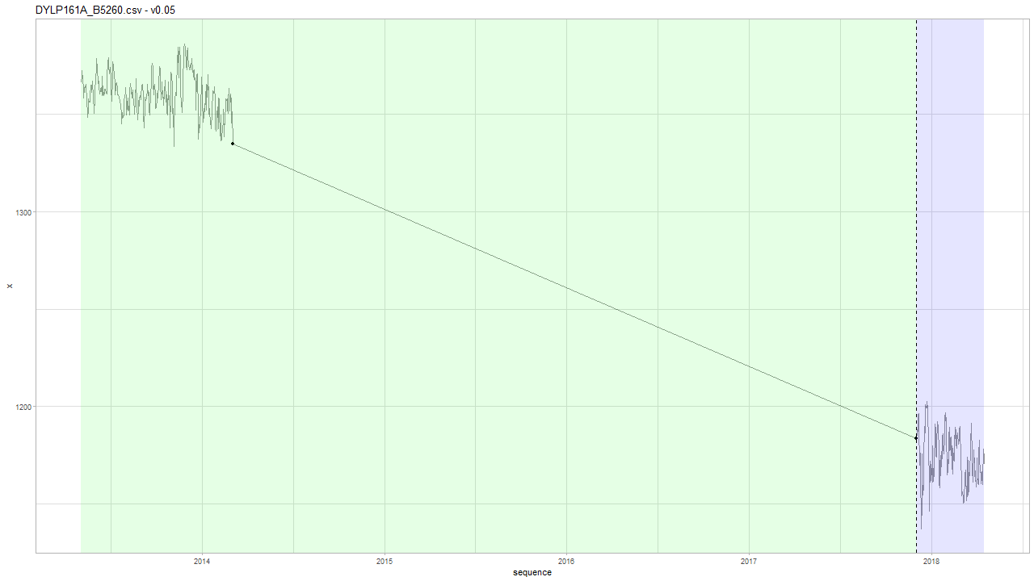

INBO: v0.05
Based on Geotech data we have $Δt$ < 1 month…
Notes:
Intuitief idee: na 4 jaar, wat is de kans dat die zo laag is gevallen?

Slide 28
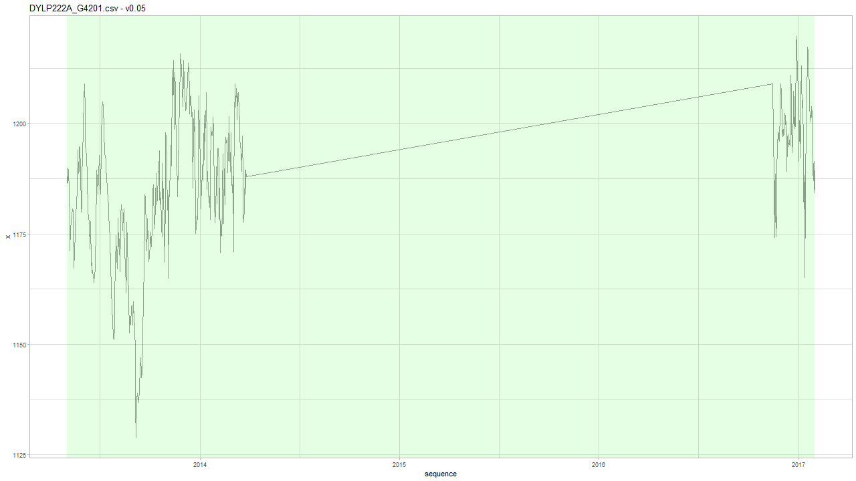
INBO: v0.05

Slide 29
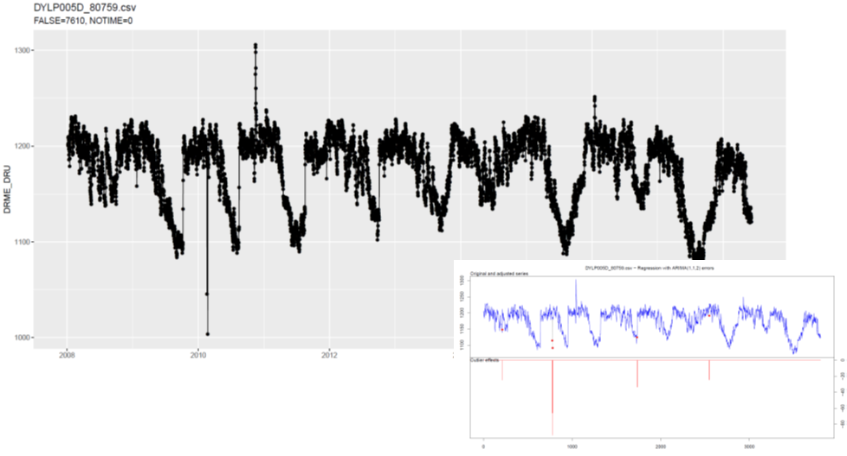
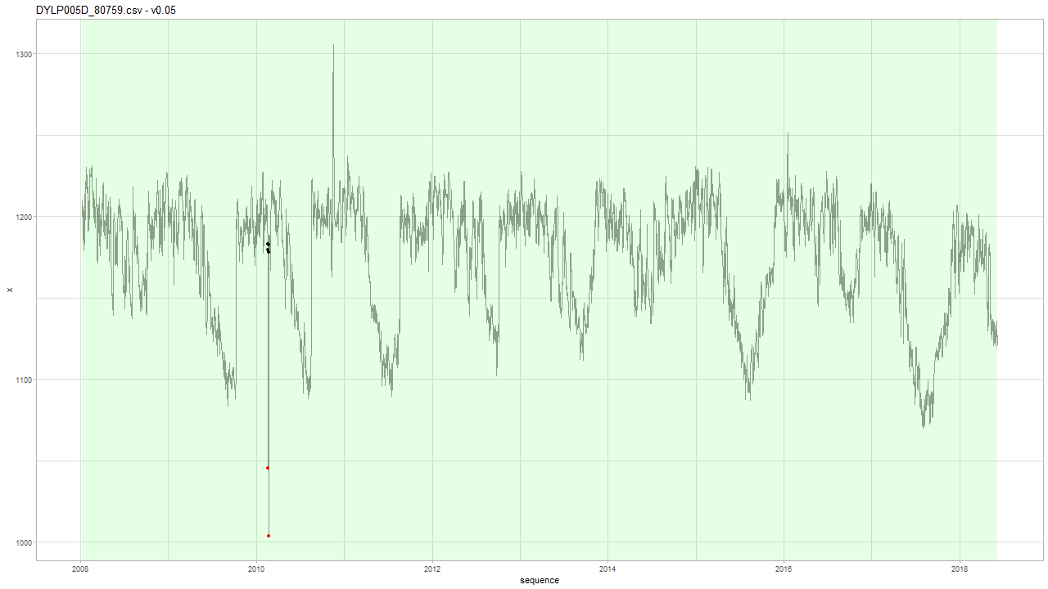
INBO: v0.05
Seasonality: yes LS: no

Slide 30
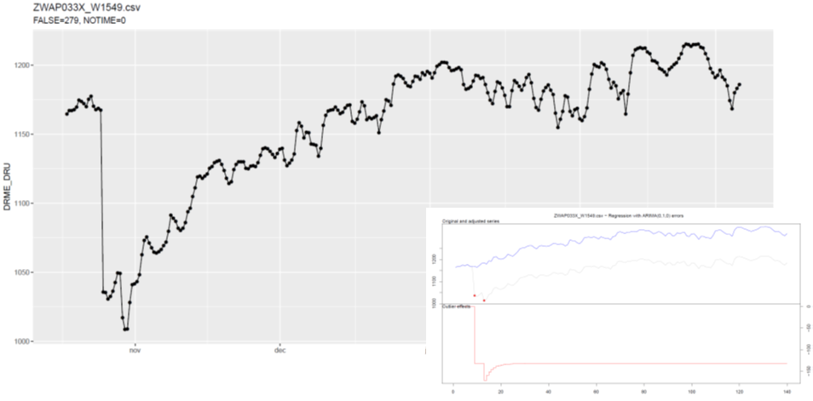
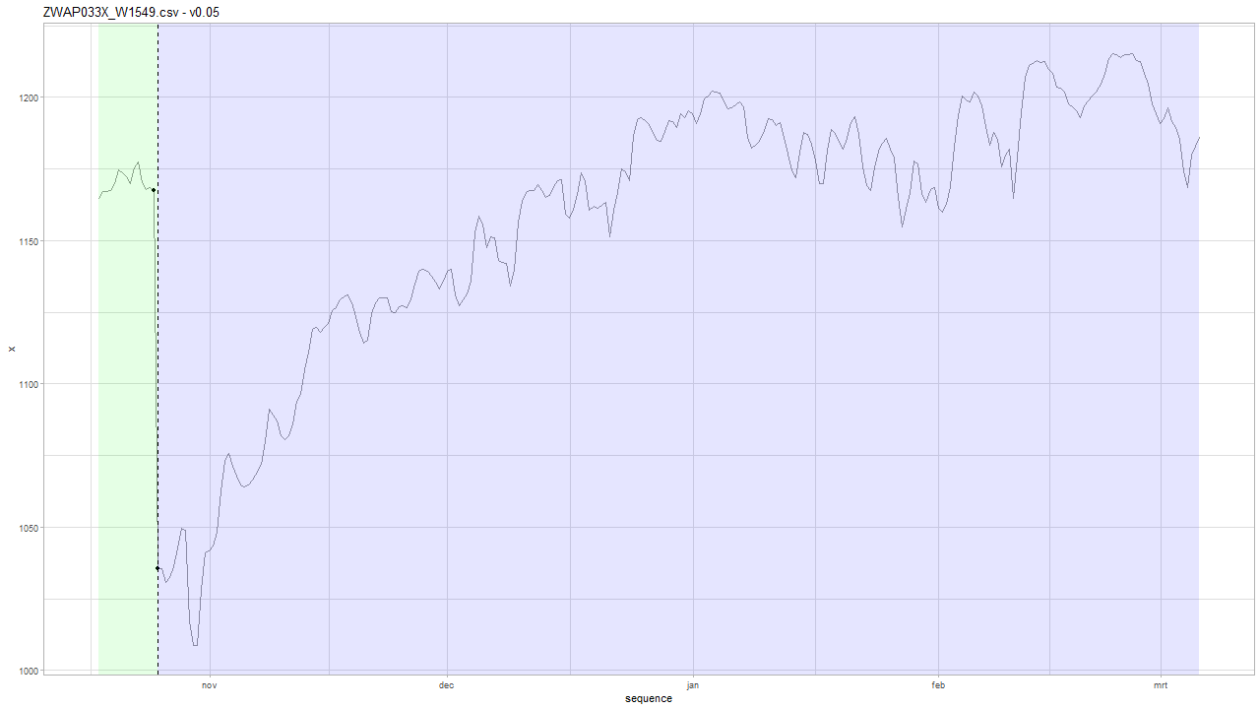
INBO: v0.05
Water withdrawal
Notes:
Water withdrawal. This should be flagged as level shift due to water withdrawal. Mathias: broken data logger... Frederic: best make difference between shifts that remain, and shifts that return? This is no ordinary LS.

Slide 31
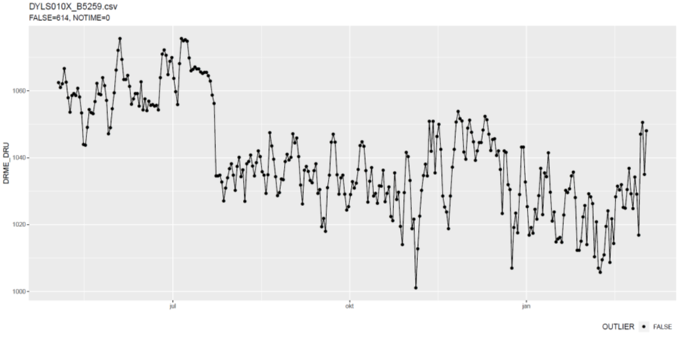
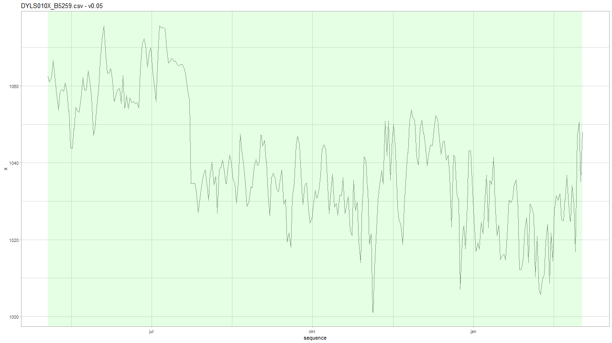
INBO: v0.05
LS? Not according to a-priori Geotech data

Slide 32
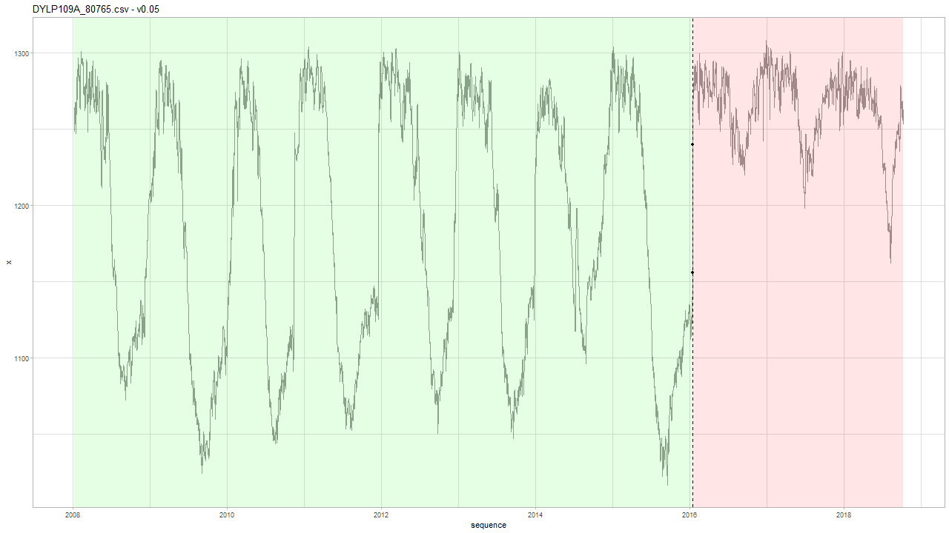
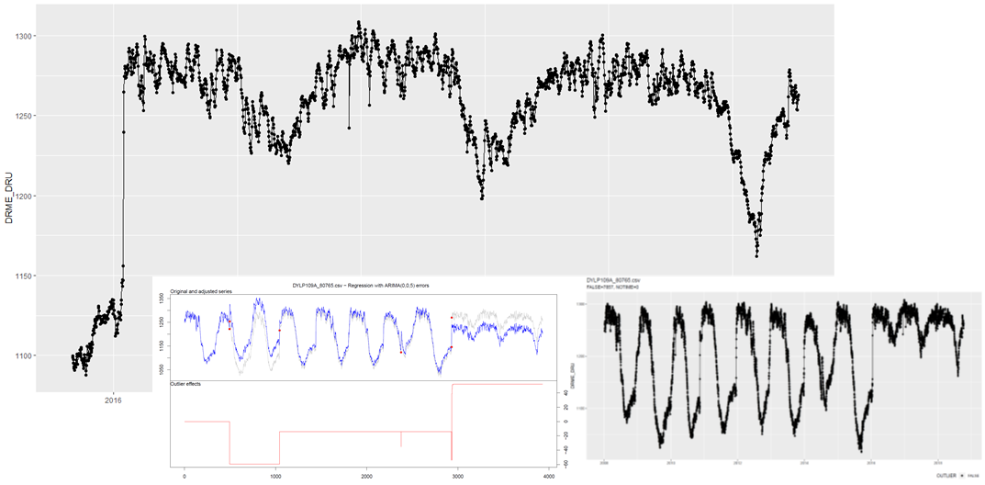
INBO: v0.05
Seasonality or tidal effects due to 12h sampling?

Slide 33
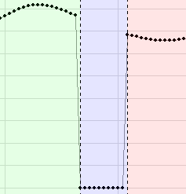
Geotech v0.05
Notes:
type index alpha delta
1: LS 673 -385.6 NA
2: LS 683 342.0 NA

Slide 34
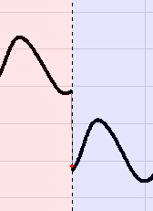




Geotech v0.05
Notes:
type index alpha delta
1: LS 8620 -74.317 NA
2: LS 8660 75.950 NA
3: AO 18420 -315.699 NA
4: LS 20693 -105.584 NA
5: AO 20693 5.075 NA
6: LS 23006 -66.091 NA
7: LS 23023 11.025 NA
8: LS 23333 122.617 NA
9: LS 31622 -369.950 NA

Slide 35
v0.06
AO, LS and TC detection

Slide 36


INBO: v0.06
Notes:
type index alpha delta
1: AO 332 -180.9308 NA
2: TC 1576 -165.0541 0.299719

Slide 37





INBO: v0.06
Notes:
type index alpha delta
1: LS 2 178.426 NA
2: TC 6 -116.917 0.548
3: TC 4218 -110.551 0.717
4: TC 4955 -179.956 0.713

Slide 38



INBO: v0.06
Threshold is set on 1/10000 = 0.0001 wrong tests….
LR test = 0.0019 for LS vs TC model.
☹
Notes:
type index alpha delta
1: LS 1906 -154.7760 NA
2: TC 2643 -205.3884 0.9
3: TC 2741 -188.7047 0.9
Browse[2]> base
[1] -6.138137
attr(,"par")
[1] -154.776
attr(,"types")
[1] "LS"
attr(,"indexes")
[1] 1
Browse[2]> pt$get(base.df + 1L)
[1] -1.326422
attr(,"par")
[1] -153.64 0.90
attr(,"types")
[1] "TC"
attr(,"indexes")
[1] 1
Browse[2]> lrtest(logL0 = base, logL = pt$get(base.df + 1L), df.diff = 1L)
[1] 0.001921106

Slide 39





INBO: v0.06
Threshold is set on 1/10000 = 0.0001 wrong tests….
LR test = 0.005 for LS vs TC model. ☹
Notes:
type index alpha delta
1: AO 1578 -54.779 NA
2: TC 1565 -99.690 0.661
3: TC 1547 -99.789 0.455
4: LS 6528 -83.536 NA

Slide 40




INBO: v0.06
Notes:
type index alpha delta
1: AO 1698 87.447 NA
2: AO 1674 -77.001 NA
3: LS 1665 73.573 NA
4: LS 1740 81.043 NA
5: AO 2097 79.124 NA
6: AO 2111 -71.188 NA
7: LS 2370 -218.148 NA
8: LS 2362 160.152 NA
9: LS 2380 152.116 NA
10: LS 2379 130.201 NA
11: LS 2382 109.761 NA
12: LS 2363 73.706 NA
13: AO 2370 49.139 NA
14: TC 2365 172.122 0.777
15: AO 2364 95.896 NA
16: LS 2676 82.418 NA
17: AO 2881 100.256 NA
18: LS 3071 587.422 NA
19: TC 3071 -421.719 0.756
20: LS 3070 70.966 NA
21: LS 3078 57.747 NA
22: AO 3119 -79.554 NA
23: LS 3107 -94.036 NA
24: LS 3110 -832.698 NA
25: LS 3108 -79.038 NA
26: LS 3114 234.116 NA
27: LS 3113 130.424 NA
28: TC 3110 745.722 0.900
29: LS 3120 138.363 NA
30: AO 3114 -101.795 NA
31: LS 3151 -120.416 NA
32: LS 3154 424.497 NA
33: LS 3149 137.709 NA
34: AO 3149 -67.512 NA
35: AO 3162 69.425 NA
36: TC 3154 -352.959 0.900
37: AO 4125 363.072 NA
38: LS 4125 128.011 NA
39: AO 4126 44.877 NA

Slide 41




Geotech: v0.06

Slide 42
Geotech: v0.05 vs. v0.06
Only differences in
born_pb 94d_151202090852_T4175.MON
born_pb 94d_160317114145_T4175.MON
born_pb 112d_151202090850_T4180.MON
pp09-1_120829130801_F5474.MON

Slide 43


Geotech: v0.06 vs. v0.05 born_pb 94d_151202090852_T4175.MON
V0.06
Notes:
type index alpha delta
1: AO 3968 -363.44550 NA
2: AO 13555 -164.79150 NA
3: AO 14117 -351.28300 NA
4: AO 18671 -98.52490 NA
5: LS 18671 -83.12519 NA
6: LS 18731 141.76297 NA
7: TC 18731 -55.43006 0.88835

Slide 44




Geotech: v0.06 vs. v0.05 born_pb 94d_160317114145_T4175.MON
V0.06 (Wrong)
V0.05 (Correct)
Notes:
type index alpha delta
1: TC 12646 -78.75362 0.9
2: LS 12819 18.66690 NA
3: LS 14964 -229.19110 NA
4: LS 14967 15.28390 NA
5: LS 17548 14.99090 NA
6: LS 18423 234.68931 NA
7: TC 18422 -26.10584 0.9
8: LS 21015 -379.05010 NA
9: LS 21051 334.48390 NA

Slide 45



Geotech: v0.06 vs. v0.05 born_pb 112d_151202090850_T4180.MON
V0.05
Takes 2 minutes to complete…
V0.06
Notes:
type index alpha delta
1: AO 3966 -336.291000 NA
2: LS 11151 -10.675097 NA
3: LS 11785 10.032903 NA
4: LS 19886 -182.234182 NA
5: AO 19908 -135.556366 NA
6: LS 19908 -28.647396 NA
7: LS 19930 35.651662 NA
8: LS 19929 24.020522 NA
9: LS 19931 18.204817 NA
10: LS 19922 98.079984 NA
11: TC 19922 -68.068404 0.861789
12: AO 19921 11.545716 NA
13: TC 19909 -49.970933 0.900000
14: LS 19928 7.035651 NA
15: LS 23049 -245.934097 NA

Slide 46


Geotech: v0.06 vs. v0.05 pp09-1_120829130801_F5474.MON
V0.06
Notes:
type index alpha delta
1: LS 12667 -115.47090 NA
2: TC 12667 67.47053 0.600487
3: AO 17938 -189.50000 NA
4: AO 26767 -340.00000 NA
5: AO 28706 -340.50000 NA

Slide 47
Summary
Compared to tsoutliers we have:
Speed: with TC detection ON, it usually takes less than a second or 2. There are few pathological cases: DYLP029A_S4054 and born_pb 112d_151202090850_T4180.MON that take 2 minutes to complete.
No need for aggregation
Variable decay
A-priori information
Variable time-intervals
Allows for step-by-step model improvement
Cons:
Ad hoc optimization (similar to tsoutliers)
Development/testing

Slide 48
Next Steps
Release version so it can be tested:
gwloggeR interface
Documentation (R-only)
Result caching:
AO, LS and TC need to be detected together: should not be recomputed for detect_levelshifts(), detect_outliers() and detect_temporalchange()
Refactor code
Better visualization of TC: draw exponential curve
Code refactoring…
Package:
version() function

Slide 49

Next Steps
Vignette for hydrostatic pressure
Summary of theoretical underpinnings of this presentation
v0.07: removing tidal effect
Should fix TC on tidal data.
Threshold for $ε(Δt)$ is now min/max value + 10 %
VMM data
make object for reading VMM data

Slide 50
The End

Slide 51
Agenda
Documentation
Diagnostic plots (outliers)
Air pressure: clean a-priori data
Universal data loading
Geotech data
Comparison outlier detection: v0.04 vs. tsoutliers
Next steps

Slide 52
Sprint 4
Documentation and diagnostic plots

Slide 53
Documentation
Vignette

Slide 54

Documentation
Vignette TOC
2 main parts:
Vignette
API interface
Goal: pkgdown-like documentation
Website-like documentation
Supported by github

Slide 55
Diagnostic plots
Outliers

Slide 56

Diagnostic plots detect_outliers(x, plot = TRUE)

Slide 57


Diagnostic plots detect_outliers(x, apriori(“air pressure”) , plot = TRUE)
A-priori (green)
$$μ=1033 cmH_{2}O$$
$$σ=9,58 cmH_{2}O$$
Notes:
Based on new data

Slide 58

Diagnostic plots detect_outliers(x, apriori(“hydrostatic pressure”) , plot = TRUE)
Notes:
Based on new data

Slide 59
Air pressure
Clean a-priori data

Slide 60

Air pressure: clean a-priori data
Notes:
Aggregated by day --> Some data is is high frequency (like BAOL033X) which has 20x or more datapoints than others, and thus has a higher weight on the distribution.
Are BAOL040X and BAOL010X and BAOL094X from the same region? And BAOL070X? This latter might be amplifying the left skewness.
Only data with a timestamp is taken into consideration.

Slide 61

Air pressure: aggregated clean a-priori data

Slide 62


Comparison: apriori air pressure red (sd/mean), green (robust), yellow (robust old data)
A-priori pressure data is as good as it can get…
Notes:
The green curve s the robust estimate for in v0.02 (mean = 1033.317 // sd = 9.586297). The yellow one is the old estimate (1034.2 // 9.93342).

Slide 63


Example (BAOL005X_72525) v0.03 (new) vs. v0.02 (old)
Notes:
Rechts: oude v0.02: eerste punt is geen outlier
Links: nieuwe v0.03: is outlier

Slide 64
Logger
Universal data loading

Slide 65

Uniform data loading: Logger object
Todo… VMM.
Static methods:
Logger::enumerate(partner = 'inbo')
Logger::enumerate(partner = 'geotech’)
Initialization:
df <- Logger('DYLP006X')$df
df <- Logger('ff_b29d_0903')$df
Uniform dataframe:
Primary key: MEASUREMENT_ID
UTC timestamp: TIMESTAMP_UTC
Value: PRESSURE_VALUE
Units: PRESSURE_UNIT
Notes:
Bedoeling is dat hier ook VMM data op een gelijkaardige manier wordt geladen.

Slide 66

VMM raw data?
http://www.ellitrack.nl/tracker/

Slide 67
Geotechniek
Outliers

Slide 68

Quick exploration
All data have timestamps without NA
Time intervals are either 5 or 15min:
5 min 15 min 1307676 436567
If necessary: best to aggregate on hourly basis?
The data is clearly seasonal and a random walk

Slide 69
Geotech outlier comparison
Main comparison file:
https://github.com/DOV-Vlaanderen/groundwater-logger-validation/blob/levelshifts/src/r/outliers/outliers_comparison_geotech.pdf
5 methods
v0.01: normality assumption
v0.02: upper level = apriori air pressure, lower level normality assumption
v0.04: based on apriori difference min(left-diff, right-diff) knowledge:
5min: max 10cmH2O
tsoutliers:
Full: AO, TC, LS
AO only highlights with difference plot

Slide 70
tsoutliers --> AO
v0.01
v0.02
v0.04
tsoutliers --> AO, TC, LS

Slide 71
Geotech outlier comparison: v0.01
Data not normal but a seasonal random walk.

Slide 72
Geotech outlier comparison: v0.01
Sometimes it works, but mostly not…

Slide 73

Geotech outlier comparison: v0.02
Similar to v0.01…

Slide 74
Geotech outlier comparison: v0.02
In the air…
“valid data”
Notes:
Voordeel is dus dat je gemakkelijk kan zien of de data wel “valid is” … maar daar stopt het wel.

Slide 75




Geotech outlier comparison: v0.04
Q&D threshold: $10 cmH2O$
Q&D threshold: $30 cmH2O$
Notes:
Treshold: 10 and 30 cmH2O

Slide 76
Geotech outlier comparison: v0.04
Detected… (cf. v0.01 not detected)

Slide 77
Geotech outlier comparison: v0.04
Detected… (cf. v0.01 not detected)

Slide 78
Geotech outlier comparison: v0.04
Detected… (cf. tsoutliers not detected due to aggregation)

Slide 79
Geotech outlier comparison: v0.04
Detected… (cf. tsoutliers not detected due to last point or agg.)

Slide 80

Geotech outlier comparison: v0.04
Missed due to multiple points. Level shift?

Slide 81

Geotech outlier comparison: v0.04
Also missed.
Level shift?

Slide 82
Geotech outlier comparison: tsoutliers
tsoutliers found it. Wrong point??

Slide 83
Geotech outlier comparison: tsoutliers
Weird… (v0.04 detects nothing)

Slide 84
tsoutliers detects two outliers? v0.04 nothing

Slide 85
Only v0.04 detected…

Slide 86
tsoutliers detects level shifts also…

Slide 87
tsoutliers aggregates: how to extract 1 single point.
Notes:
Omwille van aggregatie op uur ziet de tsoutlier plot er lichtjes anders uit.

Slide 88
Geotech outlier comparison: conclusion
v0.01 and v0.02
Normality assumption doesn’t apply to hydrostatic pressure.
v0.02 could be used to assess validity of data.
tsoutliers
Sometimes detects weird AO’s due to auto.arima model.
Slow: +10h on pp09-2_120829131517_F8511, pp08-2_120829135933_F8503, ff_b51d_090429160102_C4089
Aggregation required --> makes outlier detection and extraction of 1 point difficult.
Biggest strength is LS detection.
Personal note: we should be able to make something better.
v0.04
Is intelligible and fast.
Has no problems with first point and last point being outliers.
Is good in detecting 1 point outliers.
Has problems with > 1 point sequential outliers --> level shift?
Has best potential for outlier detection?

Slide 89
Level shifts: summary
Suggestion:
Reference algorithm (for comparison): tsoutliers
A custom approach…

Slide 90
Level shift?
Notes:
Omwille van aggregatie op uur ziet de tsoutlier plot er lichtjes anders uit.

Slide 91
No level shift?
Notes:
Omwille van aggregatie op uur ziet de tsoutlier plot er lichtjes anders uit.

Slide 92
Multiple level shifts?

Slide 93
Clear level shift.

Slide 94
Clear short level shift and outlier.

Slide 95
Next steps

Slide 96
Next steps
VMM data?
Focus on intelligible models vs. tsoutliers?
In case of outlier detection: you know “why”.
Improve and implement v0.04?
Level shifts
Improve tsoutliers (i.e. detect only large level shifts)
Make diagnostic plots for level shifts.
Custom approach…?

Slide 97
The End

Slide 98
Sprint 3
Level shifts

Slide 99
Agenda
Outliers
Level shifts
strucchange package
tsoutliers package
rank-based shift detection
Timestamps
Data aggregation
gwloggeR v0.1.2

Slide 100
Outliers
Recap

Slide 101


Outliers: v0.02
Validation
Excluded: BAOL089|BAOL079|BAOL006 (mBar)
Range: 800 < x < 1200
Notes:
Excluded: BAOL089|BAOL079|BAOL006
Range: 800 < x < 1200

Slide 102
Outliers: v0.02 example detect_outliers(x, apriori("air pressure", "cmH2O"))

Slide 103
Outliers: v0.02
Next steps
Build kernel based on clean data
Simulation test: verify power
Document in detail
Notes:
Excluded: BAOL089|BAOL079|BAOL006
Range: 800 < x < 1200

Slide 104
Level Shifts
strucchange
tsoutliers
rank-based

Slide 105
strucchange package
For modeling changes in mean

Slide 106
Level shift?

Slide 107
Strucchange package

Slide 108
Strucchange package
Pros:
Detects changes in a linear model (e.g. intercept only linear regression)
Mature package
Speed: 5 min average
Cons:
No ARIMA support
Uses lots of memory (+5GB on some cases)

Slide 109
tsoutliers package
For modeling level shifts with ARIMA models

Slide 110


tsoutliers package
Notes:
Wat hier ook kan zijn, is dat intussentijd de situatie gewoon geleidelijk is gewijzigd: dus niet abrupt.

Slide 111
tsoutliers package
Notes:
Wat hier ook kan zijn, is dat intussentijd de situatie gewoon geleidelijk is gewijzigd: dus niet abrupt.

Slide 112
tsoutliers package
Notes:
Wat hier ook kan zijn, is dat intussentijd de situatie gewoon geleidelijk is gewijzigd: dus niet abrupt.

Slide 113
tsoutliers package
More cases: see here.

Slide 114
tsoutliers package
Pros:
Allows for a wide range of ARIMA-based models
Seems to detect LS well
Speed: 10 min average with aggregation
Cons:
Can not be used without aggregation (for >5k points)
Package is still in development

Slide 115
Rank-based shift detection
For modeling level shifts with rank-based statistics

Slide 116
Rank based level shift detection
Fried, R. e.a., On rank tests for shift detection in time series, 2007
Bovik, A.C. e.a., Nonparametric Tests for Edge Detection in Noise, 1986
Based on the distribution of a test statistic (e.g. Wilcoxon statistic) the normal situation can be defined. Based on this definition, exceptional shift situations could be detected.
Pro: speed!

Slide 117
Defining Level Shift
Discussion

Slide 118
Level shift?

Slide 119
Level shift?
Notes:
Lots of missing data!!

Slide 120
Level shift?
Notes:
Lots of missing data!!

Slide 121
Level shift?

Slide 122
Level shift?

Slide 123
Level shift?
Notes:
2 shifts?

Slide 124
Level shift?
Notes:
Is rood een flat line?

Slide 125

Level shift?

Slide 126


Level shift?

Slide 127
Level shift?

Slide 128
Level shift: tsoutliers

Slide 129

Level shift?
Notes:
Is rood een flat line?

Slide 130

Level shift?
?
Notes:
Is rood een flat line?

Slide 131

Level shift?
Notes:
Is rood een flat line?

Slide 132
Timestamps

Slide 133

Timestamps: varying time-difference between observations (BAOL068X_180816.csv)
Sometimes 11, 12 or 13 hours
Notes:
BAOL068X_180816.csv

Slide 134
Timestamps: varying time-difference between observations
Equidistant observations are important for ARIMA-like timeseries models.
Without equidistance, the usability of ARIMA is limited.
Example: Differencing
For small time-differences: measured differences determined by sensor inaccuracy
For large time-differences: measured differences determined by sensor inaccuracy and atmospheric changes.
Timestamps: Take into account all kinds of scenarios?

Slide 135
Importance
Visualization:
Its either TIMESTAMP or SEQUENCE
INBO:
Can make sure that timestamp is always available.
Other parties?

Slide 136
gwloggeR
Change log
Feedback?

Slide 137
Change log
“Diver” → “hydrostatic pressure”
ap <- apriori("hydrostatic pressure", "cmH2O")
detect_outliers(x, apriori = ap)
detect_duplicates(ts)

Slide 138
Aggregation function
Lump together and take average.
Other (better?) ways?

Slide 139
Next steps

Slide 140
Next steps
Outliers v0.02
Build kernel based on clean data
Simulation test: verify power
Document in detail
Level shifts:
Gather more Level Shift examples
Better visualization
“Nederlanders”?

Slide 141
Hysteresis?

Slide 142
The End

Slide 143
Sprint 2
Outliers

Slide 144
Agenda
DRME_DMST_CDE validation
Outliers: v0.02 update
Comparison v0.01 vs v0.02
gwloggeR v0.1.1
Assessment
anomalize
tsoutliers

Slide 145
DRME_DMST_CDE
Flags from DB: ENT (entered); DEL (deleted) and INV (invalid).

Slide 146
DRME_DMST_CDE
On all *.csv-data:
DEL ENT INV VLD <NA>
462 556271 4697 16 0

Slide 147
DRME_DMST_CDE: VLD and DEL
PPNT_ID PPNT_CDE DRSO_ID DRSO_SER_NBR DRME_ID DRME_OCR_UTC_DTE DRME_DRU DRME_TPU DRME_DMTP_CDE DRME_DMST_CDE SEQUENCE
1: 7019 BAOL001X 275 D0939 238389 2010-11-11 10:00:00 1018.100 NA LDME VLD 1093
2: 7019 BAOL001X 275 D0939 1824560 2010-11-11 10:00:00 1018.075 6.033 LDME ENT 1130
3: 7019 BAOL001X 275 D0939 238390 2010-11-11 22:00:00 1007.300 NA LDME VLD 1094
4: 7019 BAOL001X 275 D0939 1824561 2010-11-11 22:00:00 1007.275 8.163 LDME ENT 1131
5: 7019 BAOL001X 275 D0939 238391 2010-11-12 10:00:00 1015.400 NA LDME VLD 1095
6: 7019 BAOL001X 275 D0939 1824562 2010-11-12 10:00:00 1015.375 11.213 LDME ENT 1132
7: 7019 BAOL001X 275 D0939 238392 2010-11-12 22:00:00 1012.900 NA LDME VLD 1096
8: 7019 BAOL001X 275 D0939 1824563 2010-11-12 22:00:00 1012.850 12.457 LDME ENT 1133
9: 7019 BAOL001X 275 D0939 238393 2010-11-13 10:00:00 1014.600 NA LDME VLD 1097
10: 7019 BAOL001X 275 D0939 1824564 2010-11-13 10:00:00 1014.600 10.810 LDME ENT 1134
11: 7019 BAOL001X 275 D0939 238394 2010-11-13 22:00:00 1012.700 NA LDME VLD 1098
12: 7019 BAOL001X 275 D0939 1824565 2010-11-13 22:00:00 1012.675 10.953 LDME ENT 1135
Duplicates: Detect those too?
Notes:
Duplicaten in de DB?

Slide 148
DRME_DMST_CDE: INV
Validation

Slide 149
DRME_DMST_CDE: INV
Validation

Slide 150

DRME_DMST_CDE: INV
Validation
No Timestamp (Inconsistent)
No Timestamp: Detect those too?
Notes:
Inconsistent because there are also black dots that have no timestamp.

Slide 151
Outliers: v0.02 update
Uses simple a-priori knowledge about air pressure, temperature, etc.

Slide 152
Outliers: v0.02 update
Validation
Excluded: BAOL089|BAOL079|BAOL006 (mBar)
Range: 800 < x < 1200
Notes:
Excluded: BAOL089|BAOL079|BAOL006
Range: 800 < x < 1200

Slide 153
Outlier comparison
v0.01, v0.02, DRME_DMST_CDE

Slide 154
Outlier comparison

Slide 155
Outlier comparison

Slide 156
Outlier comparison

Slide 157
Outlier comparison

Slide 158
Outlier comparison

Slide 159
Outlier comparison

Slide 160
Outlier comparison

Slide 161
Outlier comparison

Slide 162
tsoutliers package

Slide 163

tsoutliers package
auto.arima(Nile)
Series: Nile
ARIMA(1,1,1)
Coefficients:
ar1 ma1
0.2544 -0.8741
s.e. 0.1194 0.0605
sigma^2 estimated as 19769: log likelihood=-630.63
AIC=1267.25 AICc=1267.51 BIC=1275.04
nile.outliers <- tso(Nile,types = c("AO","LS","TC"))
nile.outliers
Series: Nile
ARIMA(0,0,0) with non-zero mean
Coefficients:
intercept LS29 AO43
1097.7500 -242.2289 -399.5211
s.e. 22.6783 26.7793 120.8446
sigma^2 estimated as 14401: log likelihood=-620.65
AIC=1249.29 AICc=1249.71 BIC=1259.71
Outliers:
type ind time coefhat tstat
1 LS 29 1899 -242.2 -9.045
2 AO 43 1913 -399.5 -3.306
Notes:
https://stats.stackexchange.com/questions/104882/detecting-outliers-in-time-series-ls-ao-tc-using-tsoutliers-package-in-r-how

Slide 164
tsoutliers package: AO’s

Slide 165
tsoutliers package: AO’s

Slide 166
tsoutliers package: AO’s
WRONG
TIMESTAMPS NOT SEQUENTIAL
Notes:
Afstandedn veel groter sinds 2018

Slide 167

tsoutliers package
Pros:
Formalism
Integration with (S)ARIMA
Cons:
Speed? (+12h on BAOL033X_C6550.csv)
Ad-hoc (messy) solution
ToDo:
Simulations for validation
Visualization of AO, LS en TC outliers
Think it best works with “all” outliers enabled.
Notes:
Zou best

Slide 168
anomalize package

Slide 169

anomalize package
vs. tsoutliers
Notes:
Same Nile dataset

Slide 170
anomalize package
Pros:
Straightforward and fast timeseries decomposition
Cons:
Only AO
LS and TC can not be specified
Not backed by decent theory
Notes:
Zou best

Slide 171
gwloggeR
Feedback?

Slide 172
Next steps

Slide 173
Next steps
Define control vocabulary?
Suggested function output:
?
Notes:
temporal change : multiple points after the change should be “red”
Level shifts: how to flag those?

Slide 174
Next steps
Go further with tsoutliers
Visualisation: level shift (LS)
Simulations
Give a better idea of model performance for specific cases
Examples:
ARIMA(0,0,0) with AO
ARIMA(0,0,0) with LS
etc.
gwloggeR versioning?
Notes:
temporal change : multiple points after the change should be “red”
Level shifts: how to flag those?

Slide 175
The End

Slide 176
Sprint 1
Outliers

Slide 177
Outliers
v0.01: detect_outliers(data)
Uses only the supplied dataset
v0.02: detect_outliers(data, type = c(“air pressure”, “air temperature”), units)
Uses simple a-priori knowledge about air pressure, temperature, etc.
v0.03: …

Slide 178
Outliers: v0.01
Uses only the supplied dataset

Slide 179
Outliers: v0.01
Validation

Slide 180
Outliers: v0.01
Validation

Slide 181
Outliers: v0.01
Validation

Slide 182
Outliers: v0.01
Validation

Slide 183
Outliers: v0.01
Validation

Slide 184
Outliers: v0.01
Validation

Slide 185
Outliers: v0.01
Validation

Slide 186
Outliers: v0.01
Validation
Scale completely wrong?

Slide 187
Outliers: v0.02
Uses simple a-priori knowledge about air pressure, temperature, etc.

Slide 188


Outliers: v0.02
Validation

Slide 189
Outliers: v0.02
Validation

Slide 190
Outliers: v0.02
Validation

Slide 191
Outliers: v0.02
Validation

Slide 192
Summary
Outliers: v0.01
detect_outliers(data)
Usable on any data (not only L - lucht)
Scale can be completely wrong (cf. BAOL018X_42112)
Outliers: v0.02:
detect_outliers(data, type = c(“air pressure”, “air temperature”), units)
Needs a-priori information
Type
Units
Fixed or dynamic thresholds?
Notes:
Tresholds voor outliers kunnen berekend worden op basis van handmatige prior analyse, of

Slide 193
Outliers: v0.03
Go even further with a-priori information?

Slide 194

Outliers: v0.03
Even more a-priori information to explain variation
Notes:
Bijvoorbeeld, somige regio’s hebben lagere of hogere temperature, wat resulteert in hogere of lagere luchtdruk.

Slide 195

Outliers: v0.03
Model for pressure based on Bernoulli’s equation:
$$P+\frac{1}{2}ρv^{2}+ρgh=constant$$
$h$
$ρ$ depends on:
Temperature (significant)
Moisture?
$v$ depends on:
Pressure (i.e. circular, so shouldn’t have any effect?)

Slide 196

Outliers: v???
First order difference: very long tails
Notes:
Very long tails, not normal

Slide 197
Next steps

Slide 198
Next steps
Make first version of package with outlier detector 0.01 and 0.02?
If no extra data supplied, use v0.01, else v0.02?
v0.02: fixed or dynamic thresholds?
Other ideas?
Notes:
Misschien best om zo snel mogelijk met package te beginnen: dan kan gebruik meteen geevalueerd worden.

Slide 199
The End

